Slide 1
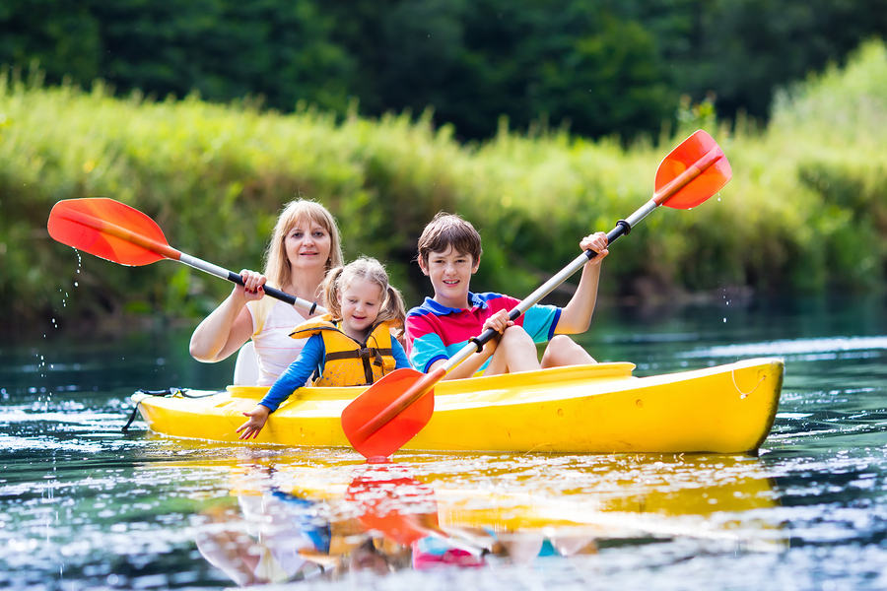
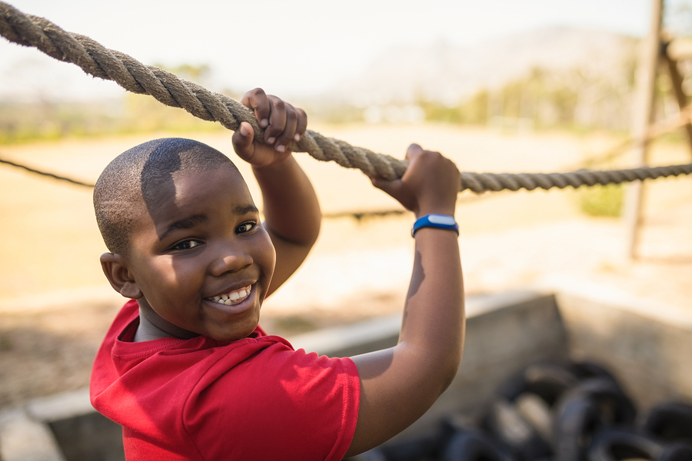
Preparing for Grief Camps
Presented by:
Andy McNiel, MA The Satori Group, LLC

Slide 2
Types of Camps
½ Day
Full-Day
Overnight (Multi-day)
Family Camps
National Camping Organizations:
Experience Camps
Camp Erin
Camp Comfort Zone

Slide 3
Staffing Camp
Company Staff
Company Volunteers
Community Volunteers
Special Considerations:
Training and Orientation
Camp Nurse
Floaters / Runners
Group Buddies
Group Leads

Slide 4
Other Considerations
Schedule and Flow
Arrival
Small Group / Large Group
Parent Involvement
Closing
Release Forms & Documentation
Emotional Support
Activities (Bonding, Supportive, Reflective)

Slide 5
Reflective Activities
Perspective Building
Problem Solving
Continuing Bonds
Meaning-Making

Slide 6
Bonding Activities
High Energy
Problem Solving
Team Building

Slide 7
Supportive Activities
Equine / Animals
Group Discussion
Yoga / Relaxation
Campfire Sharing

Slide 8
Questions?

Slide 9
CONTACT INFORMATION Andy McNiel, MA Andy.McNiel@TheSatoriGroup.org www.TheSatoriGroup.org

