Slide 1
FEBS to EGSS Transition
National Hospice and Palliative Care Organization

Slide 2
Kristi Dudash, MS Senior Manager, Research and Quality
Some things about me:
MS Gerontology
6 ½ years at NHPCO
Performance Measures and Quality Improvement
Survey Research
Previous stints in Volunteer Management with a couple hospices

Slide 3
Objectives
Describe history of FEBS and background of transition to EGSS
Know how to transition to EGSS from FEBS if current FEBS user
Understand how to implement EGSS if new user
Portal fun
Notes:
What we’ll focus on today are the objectives here, so you’ll know the history of the survey that helps evaluate your bereavement services, what’s changing with it, and how to implement it in your hospice.

Slide 4
Family Evaluation of Bereavement Services
Developed by NHPCO with University of Massachusetts and team of bereavement professionals and launched in 2007
Designed for hospices to evaluate and improve their bereavement services from the perspective of the recipient of those services
Cognitive and field testing and multiple revisions before final survey
Comprehensive approach by including questions on a wide range of services, with skip patterns to allow respondents to not answer questions that do not pertain to their experience with bereavement services

Slide 5
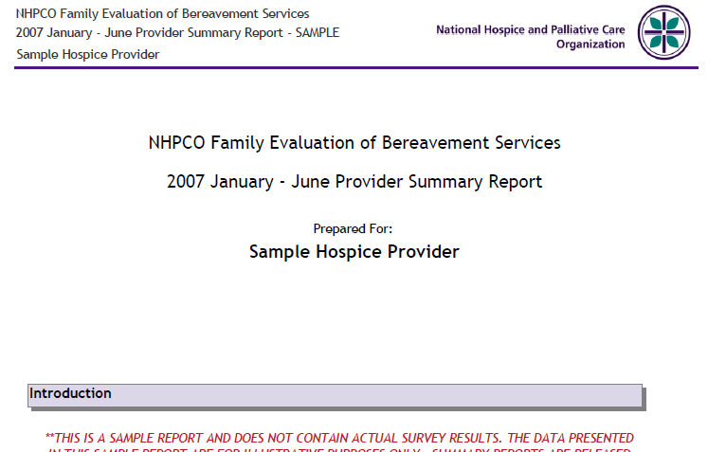
Notes:
Since its inception, we created reports for hospices twice a year with results from their surveys entered online and our analysis of all completed surveys (the comparative data) in a calendar year. The reports were posted as PDFs on Aug 1 and Feb 1 so folks could log into our DART system on or after those dates to retrieve their reports.

Slide 6
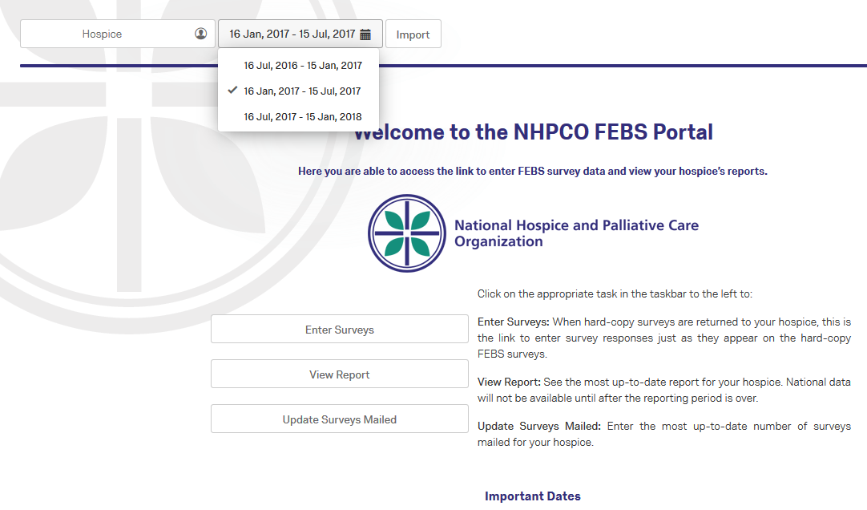
FEBS Portal in 2017
Notes:
A change in 2017 - Qualtrics created our updated FEBS Portal, a one stop shop with automatic hospice-level reports and link to enter surveys all from the same page. The nifty thing about the reports is that you can see your responses in almost real time. Sometimes there’s a data refresh so if you’re entering your surveys and then bounce over the report you may not see it reflect right away.
Side note: If you don’t see an accurate count of your responses after a 24-hr period, feel free to email egss@nhpco.org so we can help. This is true for FEBS and will be true for EGSS

Slide 7
Evaluation of Grief Support Services
With feedback from FEBS users and guidance from an advisory group of bereavement professionals, NHPCO revised the survey in 2017 and began implementation of the new survey in 2018
Because there is wide variation in the number and nature of bereavement services offered by hospices, the survey design has changed to a modular one
Comprehensive approach by including questions on a wide range of services, many of them optional so that hospices may tailor the EGSS survey to reflect the specific services they offer
Notes:
Also in 2017, we began the process of formally revising the FEBS survey, and the revision included a name change.
Takes the same comprehensive approach including questions on a wide range of services, but now they are optional so you can hone in on the specific services you offer, and we encourage you to utilize this survey and its reports as an integral and valuable component of your overall QAPI program.

Slide 8
EGSS First Steps
Review the EGSS survey and customize it as needed to reflect the services that you offer in your bereavement program
Begin mailing it out!
Once you begin receiving surveys back to your hospice, hold on to them until the Portal accepts EGSS surveys, which will be July 16
Notes:
These are the basic first steps for implementing EGSS. We’ll delve into the specifics for those who are FEBS users a few slides from now.

Slide 9
EGSS Initial Report
We posted the EGSS surveys for use in February 2018
Dates vary for when hospices initially begin mailing EGSS surveys and receiving those surveys back
For this reason, initial time period is extended so it will reflect the month we first posted the surveys for hospice use in February.
EGSS initial report will say February - December 2018. The timeframe for data entry begins July 16 and ends Jan 15
We will resume six-month EGSS reports for the Jan-June 2019 reports
Notes:
Back in mid-Feb of this year, we posted Microsoft Word versions of the EGSS surveys so that hospices could start to implement them and transition away from FEBS. Some hospices started in late February to utilize EGSS and some haven’t yet done so. For this reason, the EGSS initial report, when it posts Feb 1 with comparative data, will say “February – December 2018.”

Slide 10
Evaluation of Grief Support Services
Reports reflect the data from the surveys received back to your hospice during a particular period, usually a six-month period
For FEBS, you can start receiving surveys back to your hospice between Jan 1 and Jan 15, but data entry for the first half of the year surveys begins January 16, so you have to hold on to those surveys until January 16
Notes:
Historically, we present results reflecting a six-month period. To help explain how that timeframe works with when you enter your surveys online, FEBS is used as the example.

Slide 11
Family Evaluation of Bereavement Services
Important Dates
 | Time Period for Surveys Received | Data Submission Period | Report Available with National Comparative Data
FEBS | 1st half of year (Jan 1 – Jun 30) | January 16 – July 15 | August 1
EGSS | (Feb – Dec 31)* | July 16 – January 15 | February 1
Notes:
Now when we look at the updated Important Dates Calendar, you see when the data submission period is for FEBS and when it will be for EGSS. The data submission period is when you enter surveys that have been received back to your hospice. We purposely have an overlap of 2 weeks after the first half of the year and second half of the year (July 1 – 15) to give you extra time to enter your surveys after the end of a six-month period.
So, again, for FEBS what you did at the first of the year was hold on to any surveys received between Jan 1 and Jan 15 in order to start entering them in the current data submission period.
And for EGSS, you are holding on to any surveys received from when you started getting your first ones back all the way to July 15, and then start entering them online starting July 16.

Slide 12
FEBS to EGSS Transition Basics
EGSS will replace FEBS
FEBS last day of data entry is last day of current data submission period, July 15
You will have a FEBS Jan-June report with national comparative data August 1

Slide 13
EGSS Survey Details
Two versions
Modules
EGSS CUSTOMIZABLE
EGSS GENERIC
Notes:
On to the survey itself! There are two versions, one generic one that’s ready to go – just print off and starting mailing it out, and one that you can include the name of your bereavement program within some questions. This was done for those hospices whose bereavement programs have such a unique name and want to ensure the survey respondent is clear that the questions are being asked about the bereavement program and not the hospice.
For either the generic or customizable version, the modular functionality still applies. Let’s take a look.
Click on the document icons to open them externally.

Slide 14
EGSS Portal
If you use FEBS, it’s the same
We will have all questions, no question numbers
There will be a response option to select for questions you don’t include on your customized survey
No open-ended questions in online data entry (do recommend you track for your own purposes)

Slide 15
How To EGSS
How To EGSS
EGSS Guidelines
Notes:
Click on the documents in the slide to open them externally.
The How to EGSS explains the elective modules, why we include them, and what’s required.
The EGSS Guidelines provide the background of the survey, how to prepare in sending out the survey, and how to enter surveys online.

Slide 16
Oft-asked Questions
Q: Respondent #s – do they reset after a data submission period?
A: The respondent # is for your own tracking purposes only. Ideally make a unique # for each survey to keep track of the surveys you have entered online within a reporting period.
Surveys may be numbered in order (ex: starting with “1, 2, 3”) or a number that is meaningful for your hospice. Please note the system will allow you to enter whatever respondent number you like.
We strongly recommend a unique respondent number per survey. Do not duplicate Respondent Numbers.

Slide 17
Oft-asked Questions
Q: How do I fix my Number of Surveys Mailed?
A: The number of surveys mailed is used to calculate the response rate for your hospice for the current data submission period. Ideally, update the number on an ongoing basis.
When you log in to the EGSS Portal and click on “Update Surveys Mailed.” Update the number here and your report refreshes with the updated response rate! You can do this for any data submission period, yes, even that previous one!

Slide 18
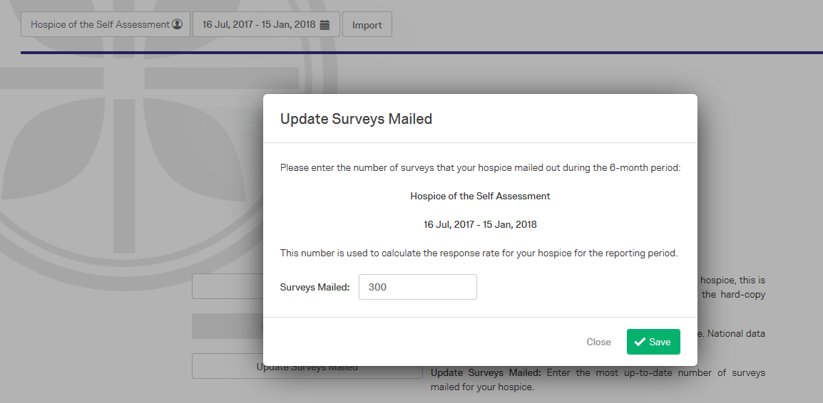

Slide 19
Oft-asked Questions
Q: Is EGSS required?
A: Data submission and reporting for this measure are voluntary and are available to you as an NHPCO member at no additional cost. You may also want to know if FEBS/EGSS is required for CMS. CAHPS is completely separate from FEBS. It’s not that Hospice CAHPS is missing bereavement. The CAHPS is focusing on the hospice care to the patient and primary caregiver, not bereavement services provided to caregivers and community... at least, not yet.

Slide 20
Oft-asked Questions
Q: Can I change the survey (delete or edit wording)?
A: The same guidelines apply to EGSS as they do for FEBS in that the survey should be used in exactly the same form as it is presented:
Only questions labeled as optional may be deleted
The order of questions within a page should not be changed
the wording of the questions should not be changed
If you choose to not include one more optional module or question:
Delete the optional module/question that don’t apply

Slide 21
NHPCO members enjoy unlimited access to NHPCO assistance!
Email us at egss@nhpco.org

